Slide 1
Chapter 5 – Control Structures: Part 2
Outline
5.1 Introduction
5.2 Essentials of Counter-Controlled Repetition
5.3 The for Repetition Structure
5.4 Examples Using the for Structure
5.5 The switch Multiple-Selection Structure
5.6 The do/while Repetition Structure
5.7 Statements break and continue
5.8 Labeled break and continue Statements
5.9 Logical Operators
5.10 Structured Programming Summary
5.11 (Optional Case Study) Thinking About Objects: Identifying Objects’ States and Activities

Slide 2
5.1 Introduction
Continue structured-programming discussion
  Introduce Java’s remaining control structures

Slide 3
5.2 Essentials of Counter-Controlled Repetition
Counter-controlled repetition requires:
  Name of control variable (loop counter)
  Initial value of control variable
  Increment/decrement of control variable through each loop
  Condition that tests for control variable’s final value

Slide 4
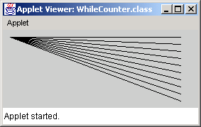
WhileCounter.java
Line 18
Line 20
Line 22
1 // Fig. 5.1: WhileCounter.java
2 // Counter-controlled repetition
3
4 // Java core packages
5 import java.awt.Graphics;
6
7 // Java extension packages
8 import javax.swing.JApplet;
9
10 public class WhileCounter extends JApplet {
11
12 // draw lines on applet’s background
13 public void paint( Graphics g )
14 {
15 // call inherited version of method paint
16 super.paint( g );
17
18 int counter = 1; // initialization
19
20 while ( counter <= 10 ) { // repetition condition
21 g.drawLine( 10, 10, 250, counter * 10 );
22 ++counter; // increment
23
24 } // end while structure
25
26 } // end method paint
27
28 } // end class WhileCounter
Control-variable name is counter
Control-variable initial value is 1
Condition tests for counter’s final value
Increment for counter

Slide 5
5.3 The for Repetition Structure
Handles counter-controlled-repetition details

Slide 6
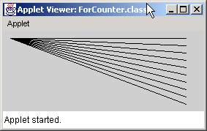
ForCounter.java
Line 20 int counter = 1;
Line 20 counter <= 10;
Line 20 counter++;
1 // Fig. 5.2: ForCounter.java
2 // Counter-controlled repetition with the for structure
3
4 // Java core packages
5 import java.awt.Graphics;
6
7 // Java extension packages
8 import javax.swing.JApplet;
9
10 public class ForCounter extends JApplet {
11
12 // draw lines on applet’s background
13 public void paint( Graphics g )
14 {
15 // call inherited version of method paint
16 super.paint( g );
17
18 // Initialization, repetition condition and incrementing
19 // are all included in the for structure header.
20 for ( int counter = 1; counter <= 10; counter++ )
21 g.drawLine( 10, 10, 250, counter * 10 );
22
23 } // end method paint
24
25 } // end class ForCounter
Control-variable name is counter
Control-variable initial value is 1
Condition tests for counter’s final value
Increment for counter

Slide 7
Line 20
for
Control variable
Final value
keyword
name
of control variable
for (
int
counter =
1
; counter <=
10
; counter++ )
Initial value
Increment
of control variable
of control variable
Loop-continuation condition
Fig. 5.3 Components of a typical for structure header.

Slide 8
5.3 The for Repetition Structure (cont.)
for ( expression1; expression2; expression3 )
statement;
can usually be rewritten as:
expression1;
while ( expression2 ) {
statement;
expression3;
}

Slide 9
Establish
int counter = 1
initial value
of control variable.
Determine if
true
g.drawLine(
final value
counter <= 10
10, 10, 250,
counter++
of control
counter * 10
Increment
variable has been
);
the control
reached.
false
Body of loop
variable.
(this may be many
statements)
Fig. 5.4 Flowcharting a typical for repetition structure.

Slide 10
5.4 Examples Using the for Structure
Varying control variable in for structure
  Vary control variable from 1 to 100 in increments of 1
    for ( int i = 1; i <= 100; i++ )
  Vary control variable from 100 to 1 in decrements of –1
    for ( int i = 100; i >= 1; i-- )
  Vary control variable from 7 to 77 in steps of 7
    for ( int i = 7; i <= 77; i += 7 )

Slide 11
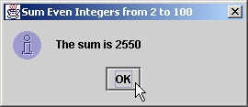
Sum.java
Line 15
1 // Fig. 5.5: Sum.java
2 // Counter-controlled repetition with the for structure
3
4 // Java extension packages
5 import javax.swing.JOptionPane;
6
7 public class Sum {
8
9 // main method begins execution of Java application
10 public static void main( String args[] )
11 {
12 int sum = 0;
13
14 // sum even integers from 2 through 100
15 for ( int number = 2; number <= 100; number += 2 )
16 sum += number;
17
18 // display results
19 JOptionPane.showMessageDialog( null, "The sum is " + sum,
20 "Sum Even Integers from 2 to 100",
21 JOptionPane.INFORMATION_MESSAGE );
22
23 System.exit( 0 ); // terminate the application
24
25 } // end method main
26
27 } // end class Sum
increment number by 2 each iteration

Slide 12
Interest.java
Line 17
Line 21
Line 22
Lines 31-34
1 // Fig. 5.6: Interest.java
2 // Calculating compound interest
3
4 // Java core packages
5 import java.text.NumberFormat;
6 import java.util.Locale;
7
8 // Java extension packages
9 import javax.swing.JOptionPane;
10 import javax.swing.JTextArea;
11
12 public class Interest {
13
14 // main method begins execution of Java application
15 public static void main( String args[] )
16 {
17 double amount, principal = 1000.0, rate = 0.05;
18
19 // create DecimalFormat to format floating-point numbers
20 // with two digits to the right of the decimal point
21 NumberFormat moneyFormat =
22 NumberFormat.getCurrencyInstance( Locale.US );
23
24 // create JTextArea to display output
25 JTextArea outputTextArea = new JTextArea();
26
27 // set first line of text in outputTextArea
28 outputTextArea.setText( "Year\tAmount on deposit\n" );
29
30 // calculate amount on deposit for each of ten years
31 for ( int year = 1; year <= 10; year++ ) {
32
33 // calculate new amount for specified year
34 amount = principal * Math.pow( 1.0 + rate, year );
35
Java treats floating-points as type double
NumberFormat can format numeric values as currency
Display currency values with dollar sign ($)
Calculate amount with for structure

Slide 13
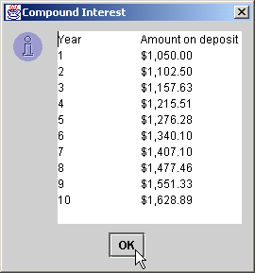
Interest.java
36 // append one line of text to outputTextArea
37 outputTextArea.append( year + "\t" +
38 moneyFormat.format( amount ) + "\n" );
39
40 } // end for structure
41
42 // display results
43 JOptionPane.showMessageDialog( null, outputTextArea,
44 "Compound Interest", JOptionPane.INFORMATION_MESSAGE );
45
46 System.exit( 0 ); // terminate the application
47
48 } // end method main
49
50 } // end class Interest

Slide 14
5.5 The switch Multiple-Selection Structure
switch structure
  Used for multiple selections

Slide 15
SwitchTest.java
Lines 19-25:
Getting user’s input
1 // Fig. 5.7: SwitchTest.java
2 // Drawing lines, rectangles or ovals based on user input.
3
4 // Java core packages
5 import java.awt.Graphics;
6
7 // Java extension packages
8 import javax.swing.*;
9
10 public class SwitchTest extends JApplet {
11 int choice; // user's choice of which shape to draw
12
13 // initialize applet by obtaining user's choice
14 public void init()
15 {
16 String input; // user's input
17
18 // obtain user’s choice
19 input = JOptionPane.showInputDialog(
20 "Enter 1 to draw lines\n" +
21 "Enter 2 to draw rectangles\n" +
22 "Enter 3 to draw ovals\n");
23
24 // convert user's input to an int
25 choice = Integer.parseInt( input );
26 }
27
28 // draw shapes on applet's background
29 public void paint( Graphics g )
30 {
31 // call inherited version of method paint
32 super.paint( g );
33
Get user’s input in JApplet

Slide 16
SwitchTest.java
Line 38: controlling expression
Line 38: switch structure
Line 54
34 // loop 10 times, counting from 0 through 9
35 for ( int i = 0; i < 10; i++ ) {
36
37 // determine shape to draw based on user's choice
38 switch ( choice ) {
39
40 case 1:
41 g.drawLine( 10, 10, 250, 10 + i * 10 );
42 break; // done processing case
43
44 case 2:
45 g.drawRect( 10 + i * 10, 10 + i * 10,
46 50 + i * 10, 50 + i * 10 );
47 break; // done processing case
48
49 case 3:
50 g.drawOval( 10 + i * 10, 10 + i * 10,
51 50 + i * 10, 50 + i * 10 );
52 break; // done processing case
53
54 default:
55 g.drawString( "Invalid value entered",
56 10, 20 + i * 15 );
57
58 } // end switch structure
59
60 } // end for structure
61
62 } // end paint method
63
64 } // end class SwitchTest
user input (choice) is controlling expression
switch structure determines which case label to execute, depending on controlling expression
default case for invalid entries

Slide 17
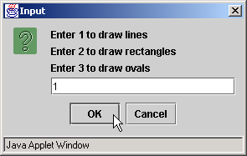

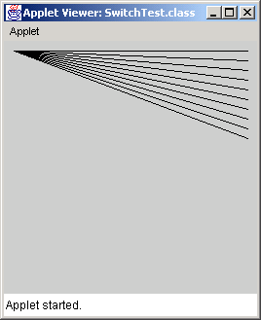
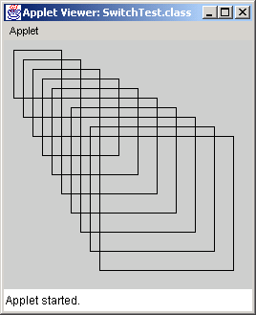
SwitchTest.java

Slide 18

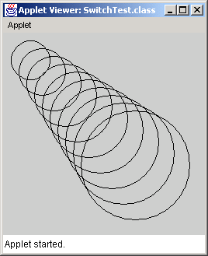
SwitchTest.java

Slide 19
true
case a
case a action(s)
break
false
true
case b
case b action(s)
break
false
true
case z
case z action(s)
break
false
default action(s)
Fig. 5.8 The switch multiple-selection structure.

Slide 20
5.6 The do/while Repetition Structure
do/while structure
  Similar to while structure
  Tests loop-continuation after performing body of loop
    i.e., loop body always executes at least once

Slide 21
DoWhileTest.java
Lines 20-24
1 // Fig. 5.9: DoWhileTest.java
2 // Using the do/while repetition structure.
3
4 // Java core packages
5 import java.awt.Graphics;
6
7 // Java extension packages
8 import javax.swing.JApplet;
9
10 public class DoWhileTest extends JApplet {
11
12 // draw lines on applet’s background
13 public void paint( Graphics g )
14 {
15 // call inherited version of method paint
16 super.paint( g );
17
18 int counter = 1;
19
20 do {
21 g.drawOval( 110 - counter * 10, 110 - counter * 10,
22 counter * 20, counter * 20 );
23 ++counter;
24 } while ( counter <= 10 ); // end do/while structure
25
26 } // end method paint
27
28 } // end class DoWhileTest
Oval is drawn before testing counter’s final value

Slide 22
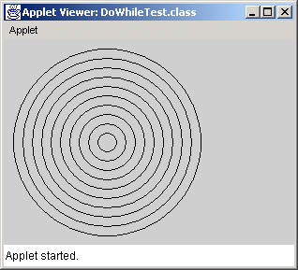
DoWhileTest.java

Slide 23
action(s)
true
condition
false
Fig. 5.10 Flowcharting the do/while repetition structure.

Slide 24
5.7 Statements break and continue
break/continue
  Alter flow of control
break statement
  Causes immediate exit from control structure
    Used in while, for, do/while or switch statements
continue statement
  Skips remaining statements in loop body
  Proceeds to next iteration
    Used in while, for or do/while statements

Slide 25
BreakTest.java
Line 16
Lines 19-20
1 // Fig. 5.11: BreakTest.java
2 // Using the break statement in a for structure
3
4 // Java extension packages
5 import javax.swing.JOptionPane;
6
7 public class BreakTest {
8
9 // main method begins execution of Java application
10 public static void main( String args[] )
11 {
12 String output = "";
13 int count;
14
15 // loop 10 times
16 for ( count = 1; count <= 10; count++ ) {
17
18 // if count is 5, terminate loop
19 if ( count == 5 )
20 break; // break loop only if count == 5
21
22 output += count + " ";
23
24 } // end for structure
25
26 output += "\nBroke out of loop at count = " + count;
27 JOptionPane.showMessageDialog( null, output );
28
29 System.exit( 0 ); // terminate application
30
31 } // end method main
32
33 } // end class BreakTest
Loop 10 times
exit for structure (break) when count equals 5

Slide 26
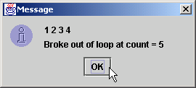
BreakTest.java

Slide 27
ContinueTest.java
Line 15
Lines 18-19
1 // Fig. 5.12: ContinueTest.java
2 // Using the continue statement in a for structure
3
4 // Java extension packages
5 import javax.swing.JOptionPane;
6
7 public class ContinueTest {
8
9 // main method begins execution of Java application
10 public static void main( String args[] )
11 {
12 String output = "";
13
14 // loop 10 times
15 for ( int count = 1; count <= 10; count++ ) {
16
17 // if count is 5, continue with next iteration of loop
18 if ( count == 5 )
19 continue; // skip remaining code in loop
20 // only if count == 5
21
22 output += count + " ";
23
24 } // end for structure
25
26 output += "\nUsed continue to skip printing 5";
27 JOptionPane.showMessageDialog( null, output );
28
29 System.exit( 0 ); // terminate application
30
31 } // end method main
32
33 } // end class ContinueTest
Loop 10 times
Skip line 22 and proceed to line 15 when count equals 5

Slide 28
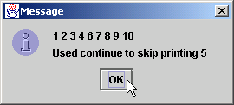
ContinueTest.java

Slide 29
5.8 Labeled break and continue Statements
Labeled block
  Set of statements enclosed by {}
  Preceded by a label
Labeled break statement
  Exit from nested control structures
  Proceeds to end of specified labeled block
Labeled continue statement
  Skips remaining statements in nested-loop body
  Proceeds to beginning of specified labeled block

Slide 30
BreakLabelTest.java
Line 14
Line 17
Line 20
Lines 23-24
1 // Fig. 5.13: BreakLabelTest.java
2 // Using the break statement with a label
3
4 // Java extension packages
5 import javax.swing.JOptionPane;
6
7 public class BreakLabelTest {
8
9 // main method begins execution of Java application
10 public static void main( String args[] )
11 {
12 String output = "";
13
14 stop: { // labeled block
15
16 // count 10 rows
17 for ( int row = 1; row <= 10; row++ ) {
18
19 // count 5 columns
20 for ( int column = 1; column <= 5 ; column++ ) {
21
22 // if row is 5, jump to end of "stop" block
23 if ( row == 5 )
24 break stop; // jump to end of stop block
25
26 output += "* ";
27
28 } // end inner for structure
29
30 output += "\n";
31
32 } // end outer for structure
33
34 // the following line is skipped
35 output += "\nLoops terminated normally";
stop is the labeled block
Loop 10 times
Nested loop 5 times
Exit to line 37 (next slide)

Slide 31
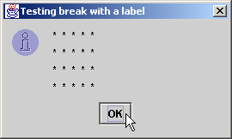
BreakLabelTest.java
36
37 } // end labeled block
38
39 JOptionPane.showMessageDialog(
40 null, output,"Testing break with a label",
41 JOptionPane.INFORMATION_MESSAGE );
42
43 System.exit( 0 ); // terminate application
44
45 } // end method main
46
47 } // end class BreakLabelTest

Slide 32
ContinueLabelTest.java
Line 14
Line 17
Line 21
Lines 24-25
1 // Fig. 5.14: ContinueLabelTest.java
2 // Using the continue statement with a label
3
4 // Java extension packages
5 import javax.swing.JOptionPane;
6
7 public class ContinueLabelTest {
8
9 // main method begins execution of Java application
10 public static void main( String args[] )
11 {
12 String output = "";
13
14 nextRow: // target label of continue statement
15
16 // count 5 rows
17 for ( int row = 1; row <= 5; row++ ) {
18 output += "\n";
19
20 // count 10 columns per row
21 for ( int column = 1; column <= 10; column++ ) {
22
23 // if column greater than row, start next row
24 if ( column > row )
25 continue nextRow; // next iteration of
26 // labeled loop
27
28 output += "* ";
29
30 } // end inner for structure
31
32 } // end outer for structure
33
nextRow is the labeled block
Loop 5 times
Nested loop 10 times
continue to line 14 (nextRow)

Slide 33
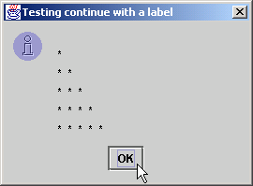
ContinueLabelTest.java
34 JOptionPane.showMessageDialog(
35 null, output,"Testing continue with a label",
36 JOptionPane.INFORMATION_MESSAGE );
37
38 System.exit( 0 ); // terminate application
39
40 } // end method main
41
42 } // end class ContinueLabelTest

Slide 34
5.9 Logical Operators
Logical operators
  Allows for forming more complex conditions
  Combines simple conditions
Java logical operators
  && (logical AND)
  & (boolean logical AND)
  || (logical OR)
  | (boolean logical inclusive OR)
  ^ (boolean logical exclusive OR)
  ! (logical NOT)

Slide 35
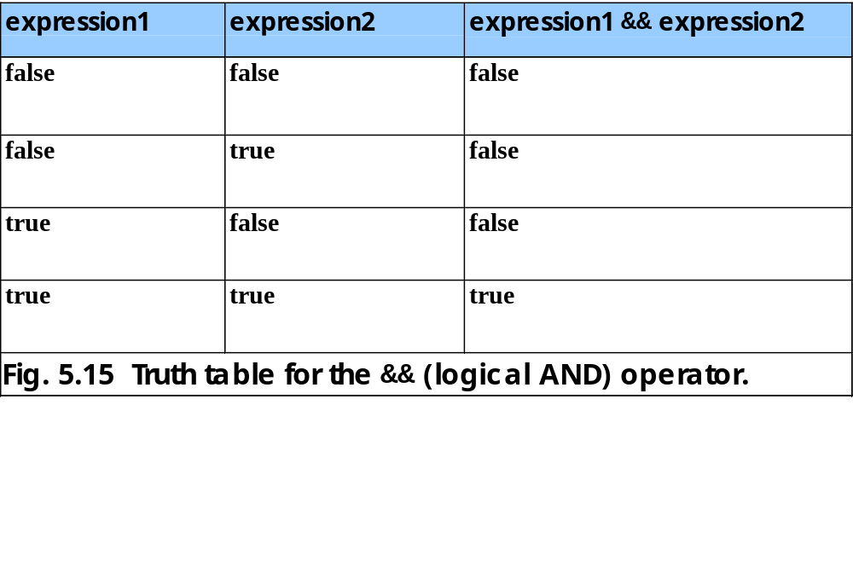

Slide 36
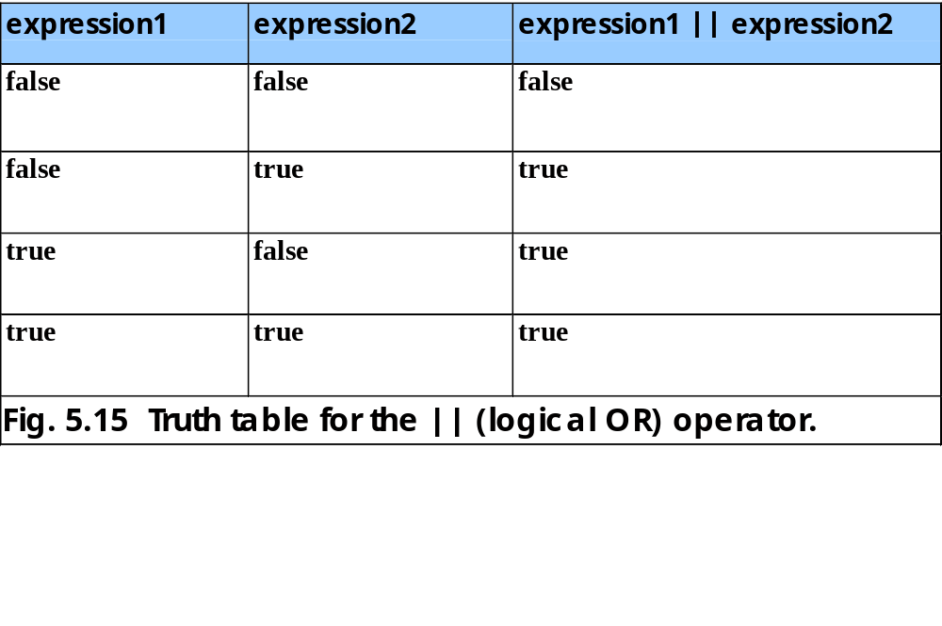

Slide 37
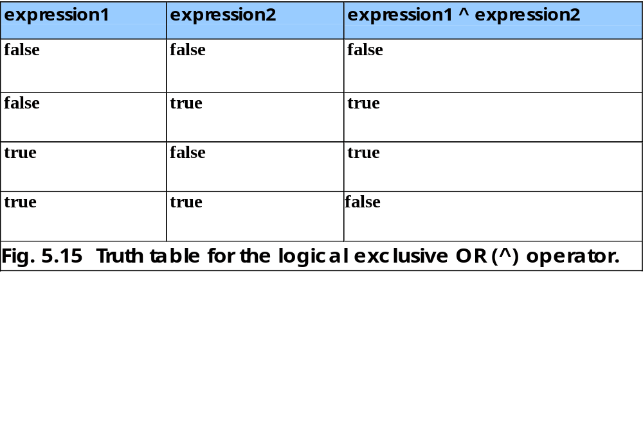

Slide 38
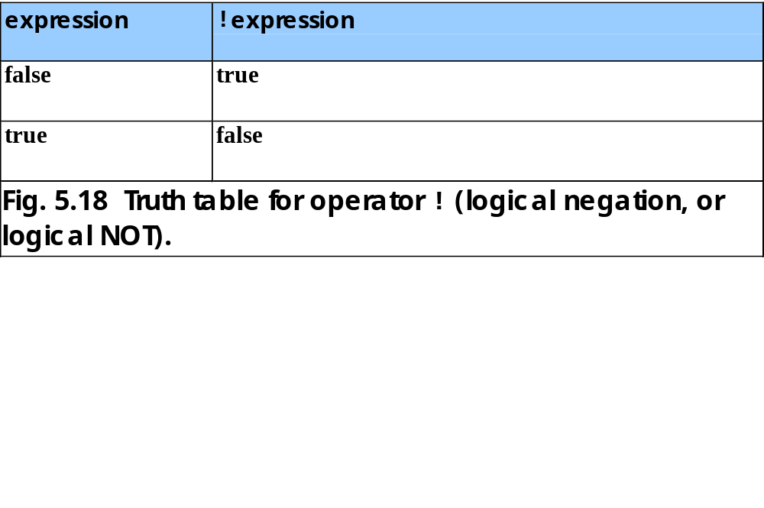

Slide 39
LogicalOperators.java
Lines 22-26
Lines 29-33
1 // Fig. 5.19: LogicalOperators.java
2 // Demonstrating the logical operators
3
4 // Java extension packages
5 import javax.swing.*;
6
7 public class LogicalOperators {
8
9 // main method begins execution of Java application
10 public static void main( String args[] )
11 {
12 // create JTextArea to display results
13 JTextArea outputArea = new JTextArea( 17, 20 );
14
15 // attach JTextArea to a JScrollPane so user can
16 // scroll through results
17 JScrollPane scroller = new JScrollPane( outputArea );
18
19 String output;
20
21 // create truth table for && operator
22 output = "Logical AND (&&)" +
23 "\nfalse && false: " + ( false && false ) +
24 "\nfalse && true: " + ( false && true ) +
25 "\ntrue && false: " + ( true && false ) +
26 "\ntrue && true: " + ( true && true );
27
28 // create truth table for || operator
29 output += "\n\nLogical OR (||)" +
30 "\nfalse || false: " + ( false || false ) +
31 "\nfalse || true: " + ( false || true ) +
32 "\ntrue || false: " + ( true || false ) +
33 "\ntrue || true: " + ( true || true );
34
Logical AND truth table
Logical OR truth table

Slide 40
LogicalOperators.java
Lines 36-40
Lines 43-47
Lines 50-54
Lines 57-59
35 // create truth table for & operator
36 output += "\n\nBoolean logical AND (&)" +
37 "\nfalse & false: " + ( false & false ) +
38 "\nfalse & true: " + ( false & true ) +
39 "\ntrue & false: " + ( true & false ) +
40 "\ntrue & true: " + ( true & true );
41
42 // create truth table for | operator
43 output += "\n\nBoolean logical inclusive OR (|)" +
44 "\nfalse | false: " + ( false | false ) +
45 "\nfalse | true: " + ( false | true ) +
46 "\ntrue | false: " + ( true | false ) +
47 "\ntrue | true: " + ( true | true );
48
49 // create truth table for ^ operator
50 output += "\n\nBoolean logical exclusive OR (^)" +
51 "\nfalse ^ false: " + ( false ^ false ) +
52 "\nfalse ^ true: " + ( false ^ true ) +
53 "\ntrue ^ false: " + ( true ^ false ) +
54 "\ntrue ^ true: " + ( true ^ true );
55
56 // create truth table for ! operator
57 output += "\n\nLogical NOT (!)" +
58 "\n!false: " + ( !false ) +
59 "\n!true: " + ( !true );
60
61 outputArea.setText( output ); // place results in JTextArea
62
63 JOptionPane.showMessageDialog( null, scroller,
64 "Truth Tables", JOptionPane.INFORMATION_MESSAGE );
65
66 System.exit( 0 ); // terminate application
Boolean logical AND truth table
Boolean logical inclusive OR truth table
Boolean logical exclusive OR truth table
Logical NOT truth table

Slide 41
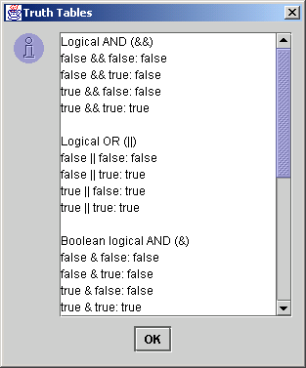
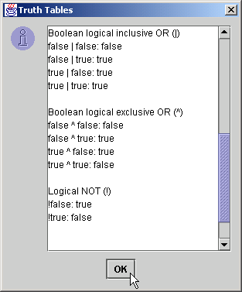
LogicalOperators.java
67
68 } // end method main
69
70 } // end class LogicalOperators

Slide 42
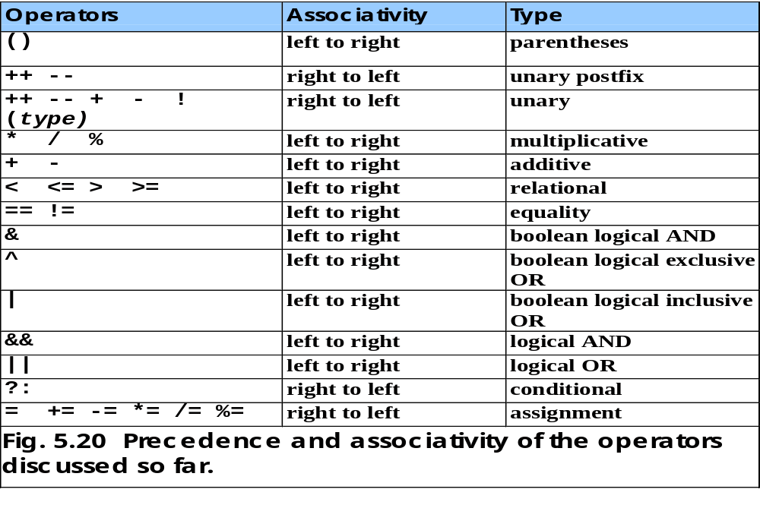

Slide 43
5.10 Structured Programming Summary
Sequence structure
  “built-in” to Java
Selection structure
  if, if/else and switch
Repetition structure
  while, do/while and for

Slide 44
Sequence
Selection
if structure
(single selection)
T
F
T
F
if/else structure
(double selection)
T
break
F
T
break
F
T
switch structure
(multiple selection)
break
F
Fig. 5.21 Java’s single-entry/single-exit control structures.

Slide 45
Repetition
while structure
do/while
structure
T
F
T
F
for structure
T
F
Fig. 5.21 Java’s single-entry/single-exit control structures.

Slide 46
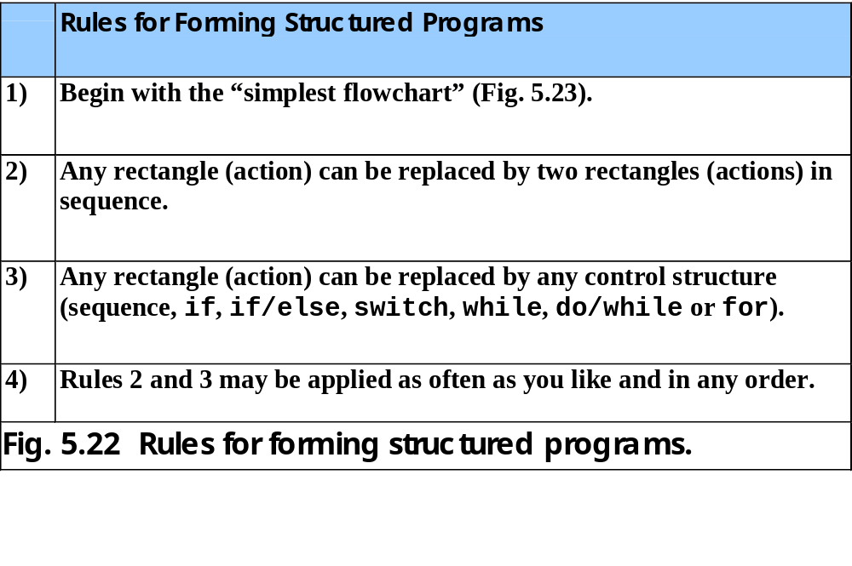
The nesting rule

Slide 47
Fig. 5.23 The simplest flowchart.

Slide 48
Rule 2
Rule 2
Rule 2
Fig. 5.24 Repeatedly applying Rule 2 of Fig. 5.22 to the simplest flowchart.

Slide 49
Rule 3
Rule 3
Rule 3
Fig. 5.25 Applying Rule 3 of Fig. 5.22 to the simplest flowchart.

Slide 50
Stacked building blocks
Nested building blocks
Overlapping building blocks
(Illegal in structured programs)
Fig. 5.26 Stacked, nested and overlapped building blocks.

Slide 51
Fig. 5.27 An unstructured flowchart.

Slide 52
5.11 (Optional Case Study) Thinking About Objects: Identifying Objects’ States and Activities
State
  Describes an object’s condition at a given time
Statechart diagram (UML)
  Express how an object can change state
  Express under what conditions an object can change state
  Diagram notation (Fig. 5.28)
    States are represented by rounded rectangles
      e.g., “Not Pressed” and “Pressed”
    Solid circle (with attached arrowhead) designates initial state
    Arrows represent transitions (state changes)
      Objects change state in response to messages
        e.g., “buttonPressed” and “buttonReset”

Slide 53
States
Transitions
Transitions occur in response to messages
Initial state
buttonReset
Not Pressed
Pressed
buttonPressed
Fig. 5.28 Statechart diagram for FloorButton and ElevatorButton objects.

Slide 54
5.11 Thinking About Objects (cont.):
Activity diagram (UML)
  Models an object’s workflow during program execution
  Models the actions that an object will perform
  Diagram notation (Fig. 5.28)
    Activities are represented by ovals
    Solid circle designates initial activity
    Arrows represents transitions between activities
    Small diamond represents branch
      Next transition at branch is based on guard condition

Slide 55
Activities
move toward floor button
[floor door closed]
press floor button
[floor door open]
wait for passenger (if there is one) to exit elevator
wait for door to open
Initial activity
enter elevator
Transitions
Branch
press elevator button
Guard condition determines next activity
wait for door to open
exit elevator
Fig. 5.29 Activity diagram for a Person object.

Slide 56
[elevator button
pressed]
set summoned to false
[button on
destination
floor
pressed]
[elevator idle]
[elevator moving]
close elevator door
[button on
destination
floor pressed]
move to destination floor
[button on
current floor
pressed]
reset elevator button
[button on
current floor
pressed]
set summoned to true
ring bell
open elevator door
[summoned]
[not summoned]
Fig. 5.30 Activity diagram for the Elevator object.

